Slide 1


Development of master curricula for natural disasters risk management in Western Balkan countries
NatRisk project
Project number: 573806-EPP-1-2016-1-RS-EPPKA2-CBHE-JP
"This project has been funded with support from the European Commission. This publication reflects the views only of the author, and the Commission cannot be held responsible for any use which may be made of the information contained therein"

Slide 2
Basic Information
Development of master curricula for natural disasters risk management in Western Balkan countries
Contract number 573806-EPP-1-2016-1-RS-EPPKA2-CBHE-JP
Project acronym NatRisk
Project name Development of master curricula for natural disasters risk management in Western Balkan countries
Project duration 15th October 2016 - 14th October 2019
Programme ERASMUS+ – Call for Proposals EAC/A04/2015
Total cost 1,245,746.00 €
Coordinator University of Niš, Serbia
Univerzitetski trg 2, 18000 Niš, Serbia
Project website www.natrisk.ni.ac.rs
Project e-mail natriskuni@gmail.com

Slide 3
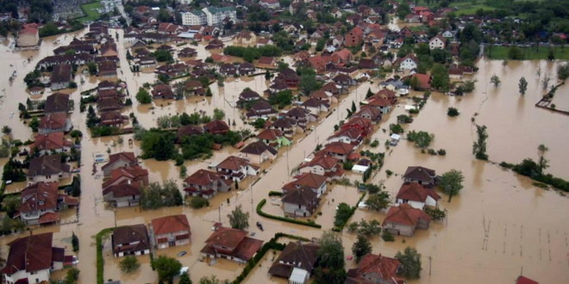
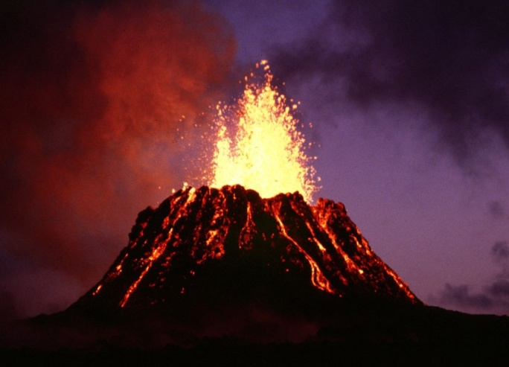
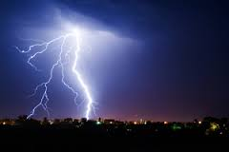
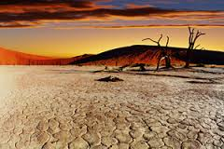
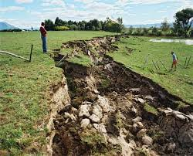
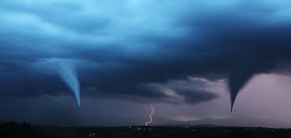

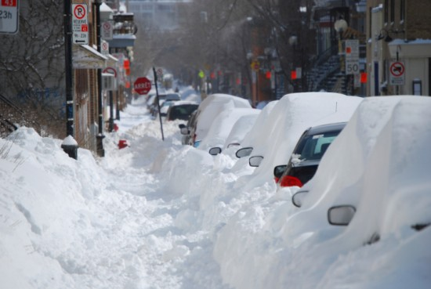
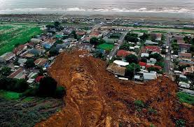
Natural hazards
Development of master curricula for natural disasters risk management in Western Balkan countries
flood
volcanic eruption
thunderstorm
drought
earthquake
tornado
high wind speed
heavy snowfall
landslide

Slide 4
Natural hazards
Development of master curricula for natural disasters risk management in Western Balkan countries
Natural hazards cause directly significant loss of life, set back economic and social development, reductions in crop yields, destruction of homes and other infrastructure and indirectly increased food prices and food insecurity.
We cannot avoid natural hazards, but we can prevent them from becoming disasters.
More than 1.5 billion people have been affected by disasters in various ways and the total economic loss was more than $1.3 trillion (Sendai Framework for Disaster Risk Reduction 2015-2030). Between 2002 and 2014 natural disasters in the EU caused over 80000 deaths and over €100 billion of economic losses.

Slide 5
Motivation
Development of master curricula for natural disasters risk management in Western Balkan countries
Management of natural disasters became the greatest global challenge and an indispensable requirement for sustainable development and is set as a goal both in Europe 2020 (target 3. climate change) and the 2030 agenda for Sustainable Development United Nations (“Goal 13. Take urgent action to combat climate change and its impacts“).
WB countries should above all develop new or improve the existing education in this field, to raise technical capacity and accomplish creation of more efficient systems for better response when natural disasters occur.

Slide 6
Overall Broader Objective
Development of master curricula for natural disasters risk management in Western Balkan countries
Education of experts for prevention and management of natural disasters in the region of Western Balkan (WB) according to the national and EU policies.

Slide 7
Specific Objectives
Development of master curricula for natural disasters risk management in Western Balkan countries
Development and implementation of methodology for identification of natural disasters to be managed in WB region and all aspects of prevention and consequences in order to define specific competencies for professional practice
Development and implementation of the new advanced master curricula in Natural Disasters Risk Management (NDRM) in line with the Bologna requirements and national accreditation standards
Development of trainings for the public sector and citizens for reaction in case of various natural disasters

Slide 8
Project Realisation
Development of master curricula for natural disasters risk management in Western Balkan countries
Identification and analysis of WB problems and needs in NDRM, comparison of best practices in EU and WB, determination of discrepancy level of NDRM in EU and WB (by May 2017).
Development of master curricula with all necessary elements in line with the Europe 2020 strategy, ET 2020, Standards and Guidelines for Quality Assurance in the European Higher Education Area and the Bologna requirements, training of teaching staff (by December 2017), upgrading teaching environment (by June 2017).
Development of educational trainings for citizens and public sector (by February 2018).
Implementation of master curricula with students’ internships and student and staff mobilities (since May 2018) and trainings (since December 2017).

Slide 9
Student Involment
Development of master curricula for natural disasters risk management in Western Balkan countries
Students will be informed about developed new master curricula and provided internships in WB and EU partner countries and they will be given opportunity to study in EU within the Special Mobility Strand (45 mobilities).
Students feedback through the self-evaluation of master curricula will be one of the main indicators of the project quality.
Students will be actively involved in promotion of developed master curricula.

Slide 10
Sustainability
Development of master curricula for natural disasters risk management in Western Balkan countries
Seven new master programmes in NDRM at the WB partner HEIs that will be developed, accredited and implemented.
Three new training programmes in NDRM (one per each WB partner country) with training materials for public sector and citizens developed and conducted.
Retrained teaching staff with up-to-date knowledge in NDRM to teach on the new master programmes.
Advanced teaching and learning process introduced.
Introduced new laboratory equipment, library units and software necessary for the continuation of the new master programmes.

Slide 11





Consortium
Development of master curricula for natural disasters risk management in Western Balkan countries
EU partners
University of Natural Resources and Life Sciences, Vienna (BOKU, AUSTRIA)
Middlesex University Higher Education Corporation (MUHEC, UK)
University of Messina (UNIME, ITALY)
Óbuda University (OE, HUNGARY)
Technical University of Crete, Chania (TUC, GREECE)

Slide 12







Consortium
Development of master curricula for natural disasters risk management in Western Balkan countries
Western Balkan partners
University of Niš (UNI, Serbia)
Academy of Criminalistics and Police Studies (KPA, Serbia)
University of Pristina in Kosovska Mitrovica (UPKM, Kosovo*)
University of Sarajevo (UNSA, Bosnia and Herzegovina)
Republic of Srpska - Ministry of Interior, Police College, Department for police education (VSUP, Bosnia and Herzegovina)
Technical College of Applied Sciences Urosevac with temporary seat in Leposavic (TCASU, Kosovo*)
University of Defence in Belgrade (UNID, Serbia)

Slide 13

Consortium
Development of master curricula for natural disasters risk management in Western Balkan countries
Associated partner
Republic Hydrometeorological Service of Serbia

Slide 14
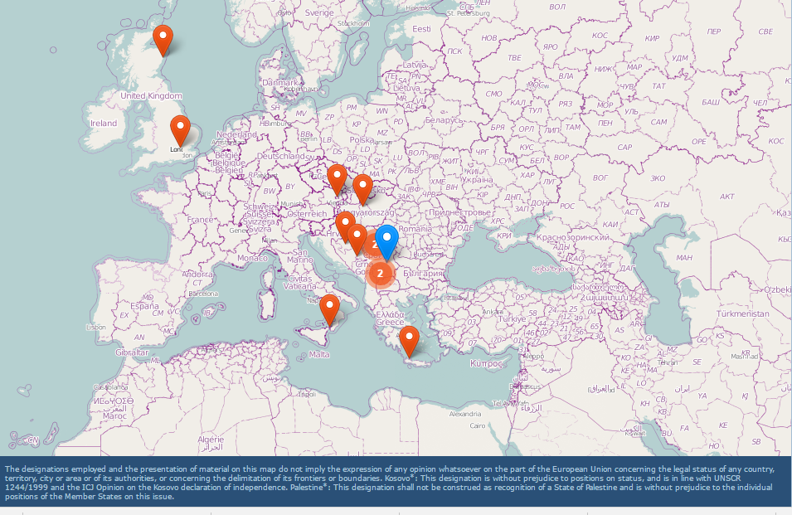
Development of master curricula for natural disasters risk management in Western Balkan countries
NatRisk Map
Source: http://ec.europa.eu/programmes/erasmus-plus/projects/eplus-project-details-page/?nodeRef=workspace://SpacesStore/c3a0d5cf-9f44-40b1-8731-23c187fc13ee

Slide 15
Work Packages
Development of master curricula for natural disasters risk management in Western Balkan countries
Preparation WP1: Analysis of natural disasters needed to be managed in Western Balkan region
Leader: University of Natural Resources and Life Sciences, Vienna
Preparation WP2: Development of master curricula
Leader: University of Messina
Preparation WP3: Development of trainings for citizens and public sector
Leader: University of Defence in Belgrade
Development WP4: Implementation of developed master curricula and trainings
Leader: University of Sarajevo

Slide 16
Work Packages
Development of master curricula for natural disasters risk management in Western Balkan countries
Quality Plan WP5: Quality assurance and monitoring
Leader: Middlesex University Higher Education Corporation
Dissemination & Exploitation WP6: Dissemination
Leader: University of Niš
Dissemination & Exploitation WP7: Exploitation
Leader: University of Niš
Management WP8: Project management
Leader: University of Niš

Slide 17
Workplan for project year 1
Development of master curricula for natural disasters risk management in Western Balkan countries
Activities |  | Total duration (number of weeks) | M1 | M2 | M3 | M4 | M5 | M6 | M7 | M8 | M9 | M10 | M11 | M12
Ref.nr/ Sub-ref nr | Title
1.1 | Identification of natural disasters to be managed in WB | 18 | 3X= | 3X | 3X | 3X | 3X= | 3X=
1.2 | Introduction with established practices in EU countries for NDRM | 18 | 3X= | 3X | 3X | 3X | 3X= | 3X=
1.3 | Workshop on master curricula best practices in EU countries | 11 |  |  |  |  | 3= | 4= | 4X=
2.1 | Development of aims, specific competencies and learning competencies of master curricula in WB HEIs | 11 |  |  |  |  |  | 2X | 2X | 2X | 2X | 3X
2.2 | Development of courses content and syllabi | 26 |  |  |  |  |  | 3X | 3X | 4X | 4X | 4X | 4X | 4X
2.3 | Training of teaching staff for innovative teaching methods | 9 |  |  |  |  |  |  | = | 2= | 2= | = | = | 2=
2.4 | Providing of students’ internships positions | 1 |  |  |  |  |  |  |  |  | X | X | X | X
2.5 | Harmonization of teaching environment with EU best practices and purchasing of laboratory equipment and literature | 11 |  | 2X | 2X | X | X | X | 2X | 2X
3.1 | Surveillance of citizens’ and public sector awareness regarding natural disasters | 16 |  | 2X | 3X | 3X | 4X | 4X
3.2 | Study visits and analysis of courses best practices in EU countries | 9 |  |  |  |  |  |  | = | 2= | 2= | = | = | 2=
3.3 | Development of trainings’ content corresponding educational materials and selection of teaching staff | 9 |  |  |  |  |  |  |  |  |  | 3X= | 3X | 3X
4.1 | Defining of admission requirements and enrolment of students | 0
4.2 | Implementation of master curricula | 0
4.3 | Implementation of students’ internships | 0
4.4 | Implementation of trainings for citizens and public sector | 0
4.5 | Self-evaluation of master curricula | 0
4.6 | Self-evaluation of trainings for citizens and public sector | 0
5.1 | Regular Quality Assurance Committee meetings | 5 |  |  |  |  |  | 2X= |  |  |  |  |  | 3X=
5.2 | Development of the quality control plan | 6 | 2X= | 2X= | 2X=
5.3 | Conduct external review of the project | 0
5.4 | External financial control | 0
5.5 | Inter-project coaching | 0
6.1 | Creation of the dissemination plan for the project | 6 |  |  | 2X= | 2X= | 2X=
6.2 | Development and maintenance of project website and creation of promotional materials and campaigns | 10 |  | 2X | 2X= | X= | X= | X= | X | X | X | X | X | X
6.3 | Promotional activity for student enrolment | 0
6.4 | Promotional activity for trainings | 2 |  |  |  |  |  |  |  |  |  |  | X | X
7.1 | Creation of sustainability plan | 6 |  | 2X= | 2X= | 2X=
7.2 | Accreditation of master curricula | 0
7.3 | Realization of student and staff mobilities between WB and EU partners | 0
8.1 | Kick-off meeting | 2 | 3X=
8.2 | Regular Steering Committee and Project Management meetings | 5 |  |  |  |  |  | 2X= |  |  |  |  |  | 3X=
8.3 | Development of guidelines on the project management and reporting | 6 |  |  | 2X= | 2X= | 2X=
8.4 | Day-to-day coordination of project activities | 15 | 2X= | 2X= | 2X= | 2X= | 2X= | 2X= | 2X= | 2X= | 2X= | 2X= | 2X= | 2X=
8.5 | Submission of interim and final reports | 0

Slide 18
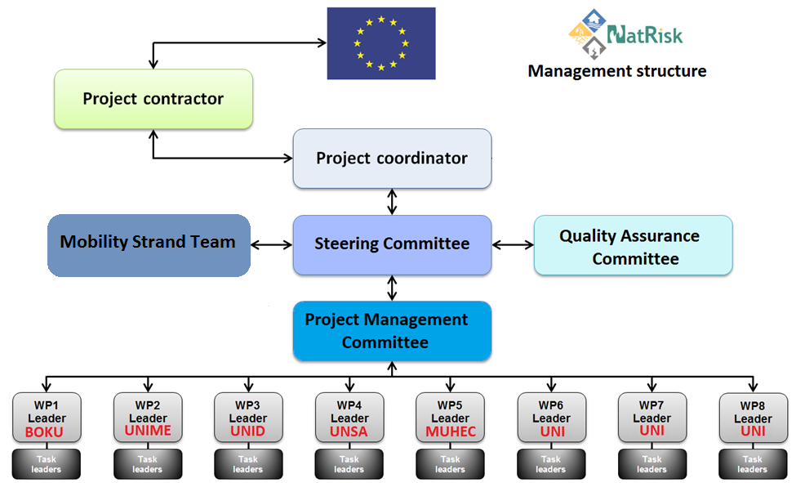
Development of master curricula for natural disasters risk management in Western Balkan countries

Slide 19
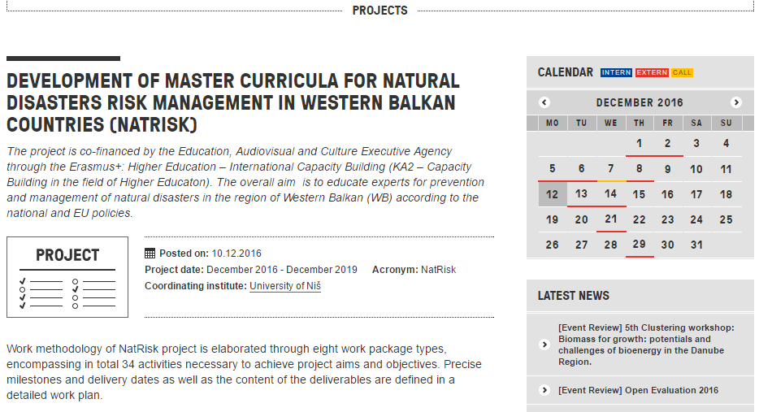
NatRisk in media
Development of master curricula for natural disasters risk management in Western Balkan countries
https://danube-inco.net/object/project/18348

Slide 20
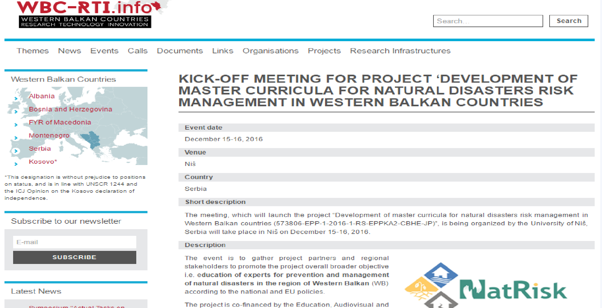
NatRisk in media
Development of master curricula for natural disasters risk management in Western Balkan countries
https://wbc-rti.info/object/event/15578#rel

